Slide 1
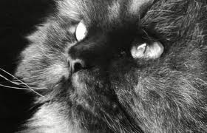
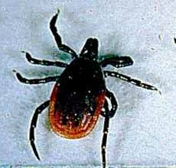
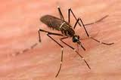
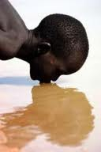
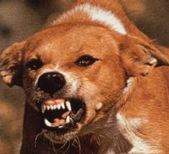
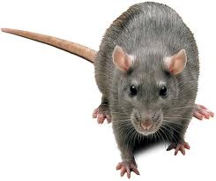
Infectious Diseases
Lesson 3.2

Slide 2
Lesson Objectives:
After finishing today’s lesson, you will be able to:
explain the role of reservoirs in pathogens’ life cycles and give one example.
explain the role of vectors in pathogens’ life cycles and give one example.
describe the preventative measures used to limit infectious spread of Lyme disease and malaria.

Slide 3
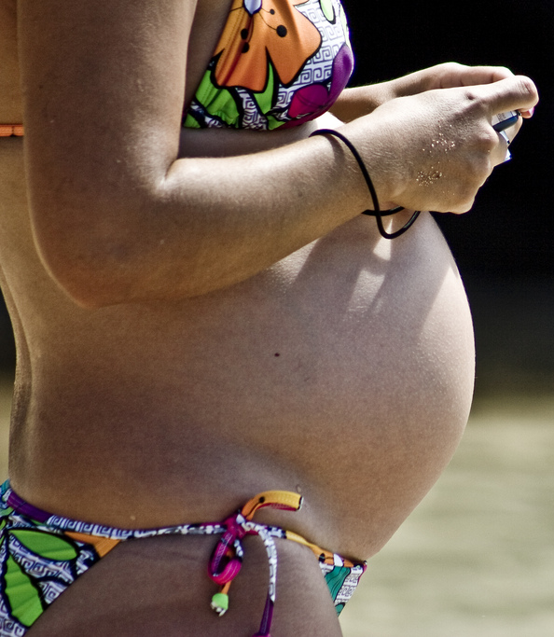
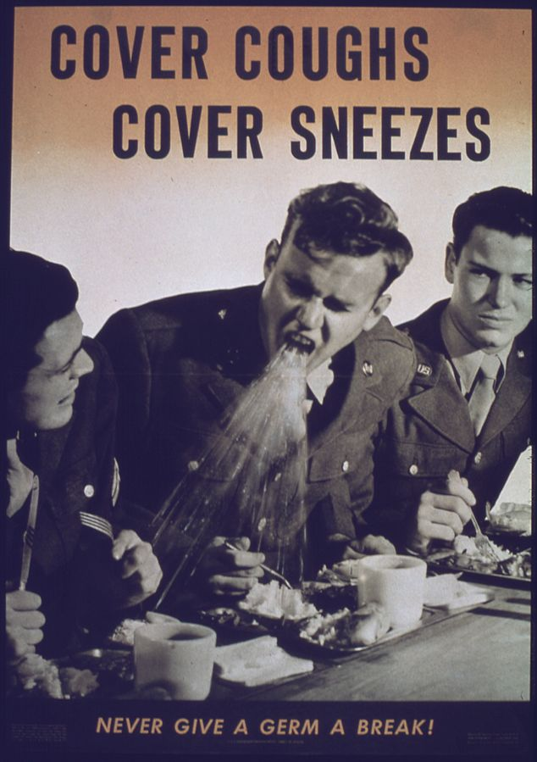
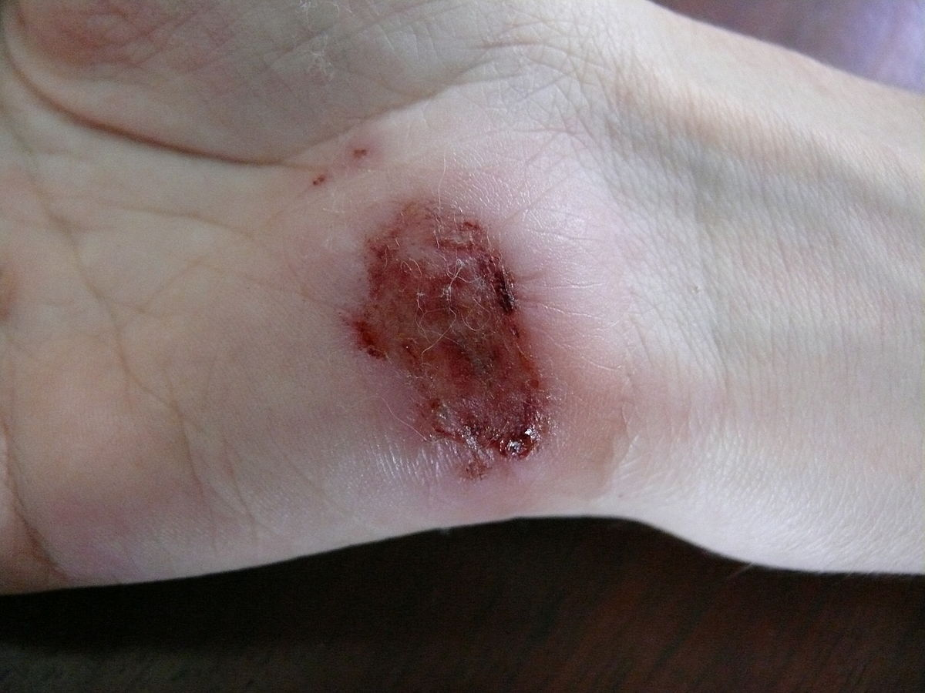
Do Now
How do pathogens gain access to their hosts?

Slide 4
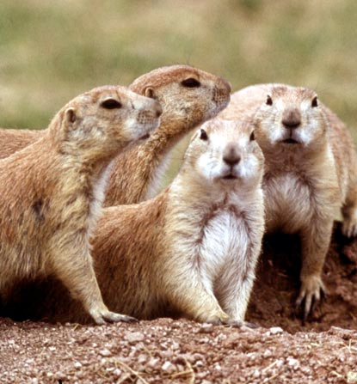
Reservoirs are sources of the pathogen in the environment.
Vectors are actively involved in the pathogen life cycle and are essential for transmission to humans.
Prairie dogs are reservoirs for the plague microbe.

Slide 5
Jigsaw Activity: Reservoirs and Vectors
In small groups complete the reading and fill in the table in your worksheet for either malaria or Lyme disease.
Prepare to teach your classmates about the:
Infectious agent
Prevalence
Vector and reservoir
Life cycle
Symptoms
Diagnosis
Treatments
Public Health issues/prevention
When listening to the other group teach, fill in the rest of the table.

Slide 6
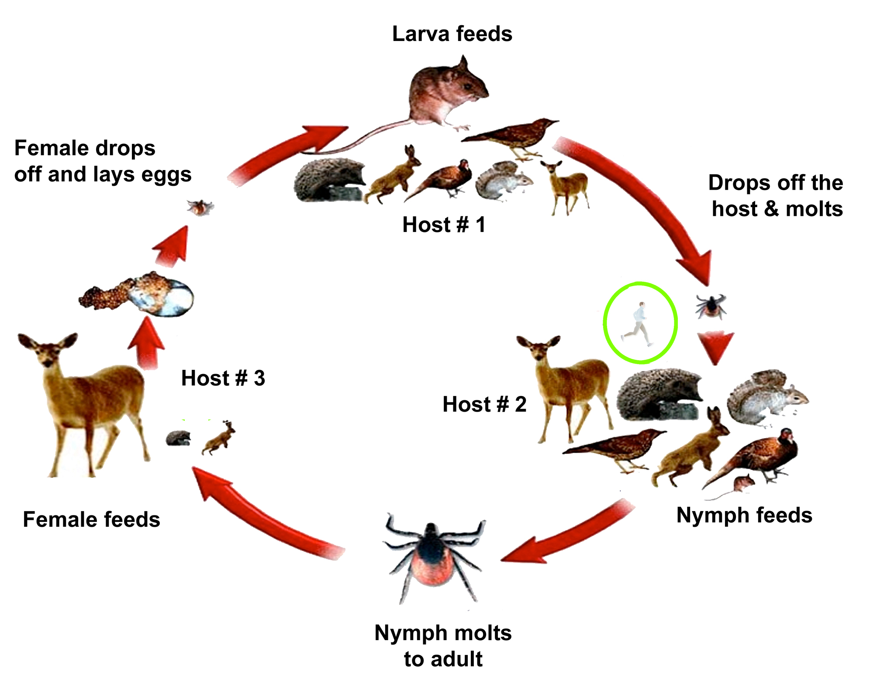
Lyme disease

Slide 7
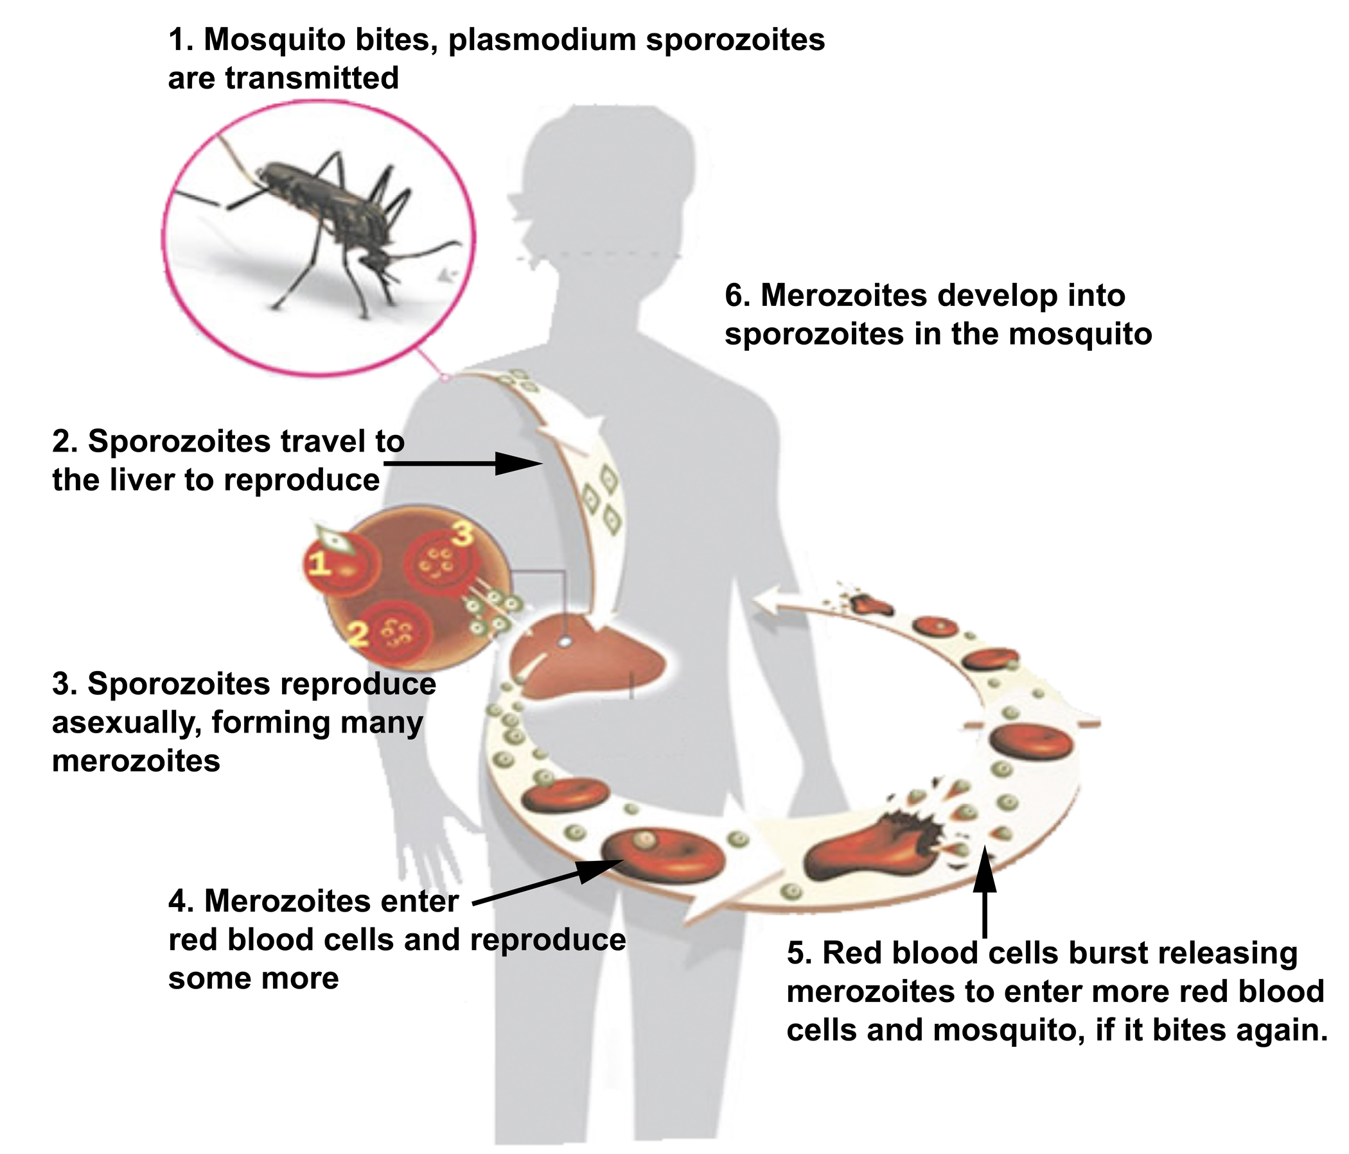
Malaria

Slide 8
Wrap Up
What advice would you give to someone walking in grassy fields?
What advice would you give to someone traveling to the tropics?

Slide 9
Homework
Complete the lesson worksheet as homework if you ran out of time during class.
Write two short paragraphs describing the life cycle of the pathogen you chose for your final project.

